Slide 1
Dog “Simulator” Toy
A Small Canine Friend
By the New York Rat, Sydney Gardner
Updated Edition

Slide 2
Essential Features
The dog’s eyes will follow the mouse cursor around (if the cursor moves off the Perlenspiel grid and cannot be tracked, the dog will look forward again)
If the user clicks the dog’s eyes, it will wince. If clicked anywhere else, the dog will bark.
If the user clicks the dog’s nose, a different reaction will play
The collar will ding if clicked

Slide 3
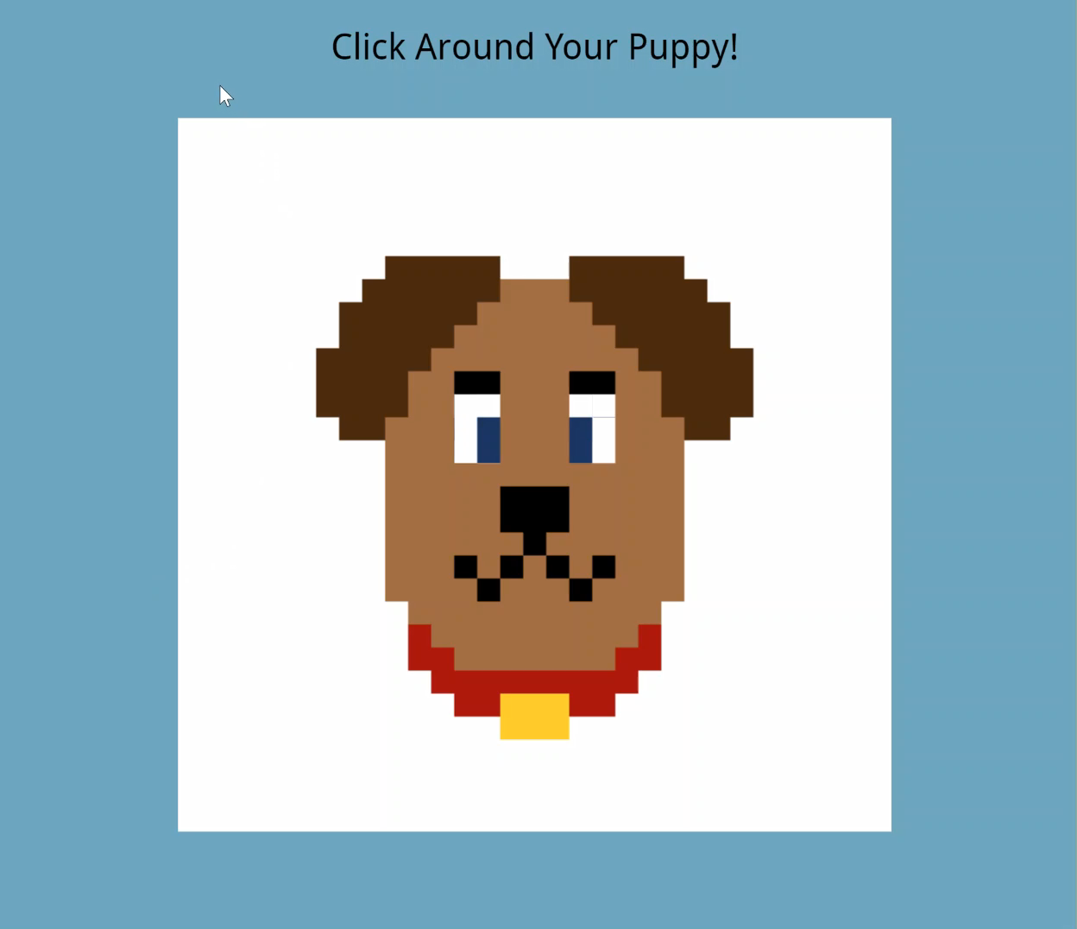
The Default Dog
First image shows the default dog, looking straight forward. This will be if the cursor is directly in front of the dog or if it is off the designated Perlenspiel grid.

Slide 4
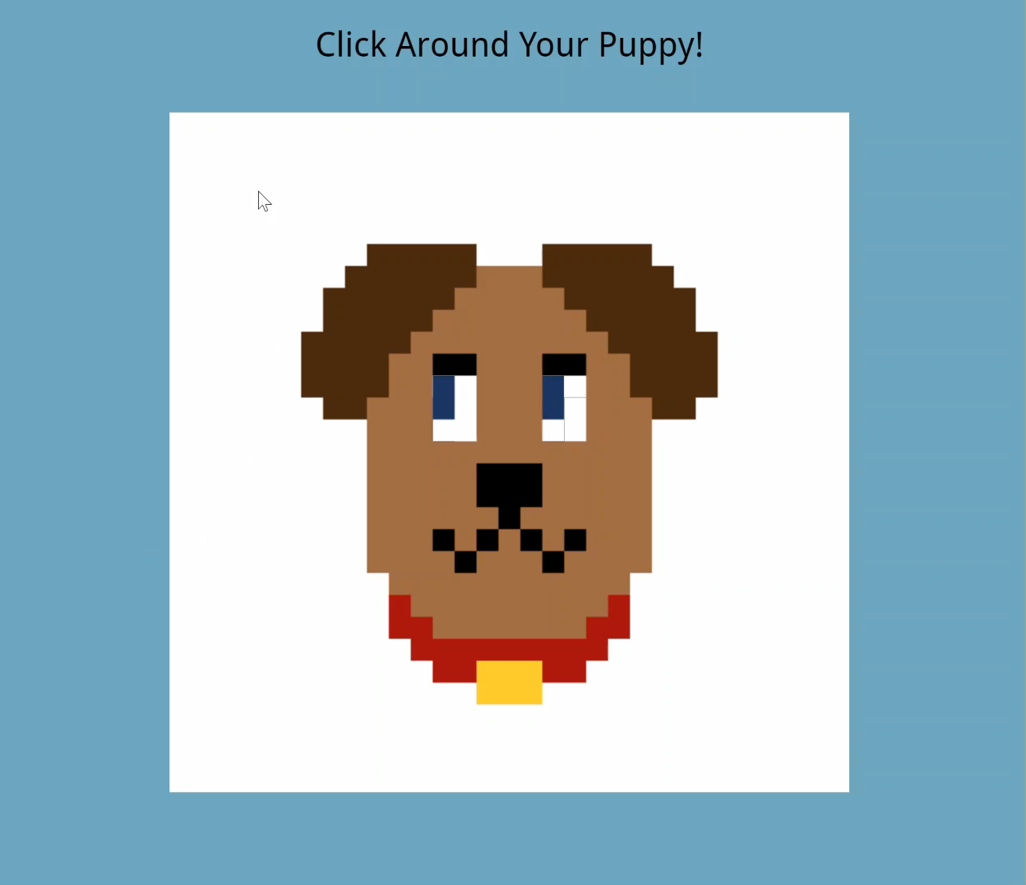
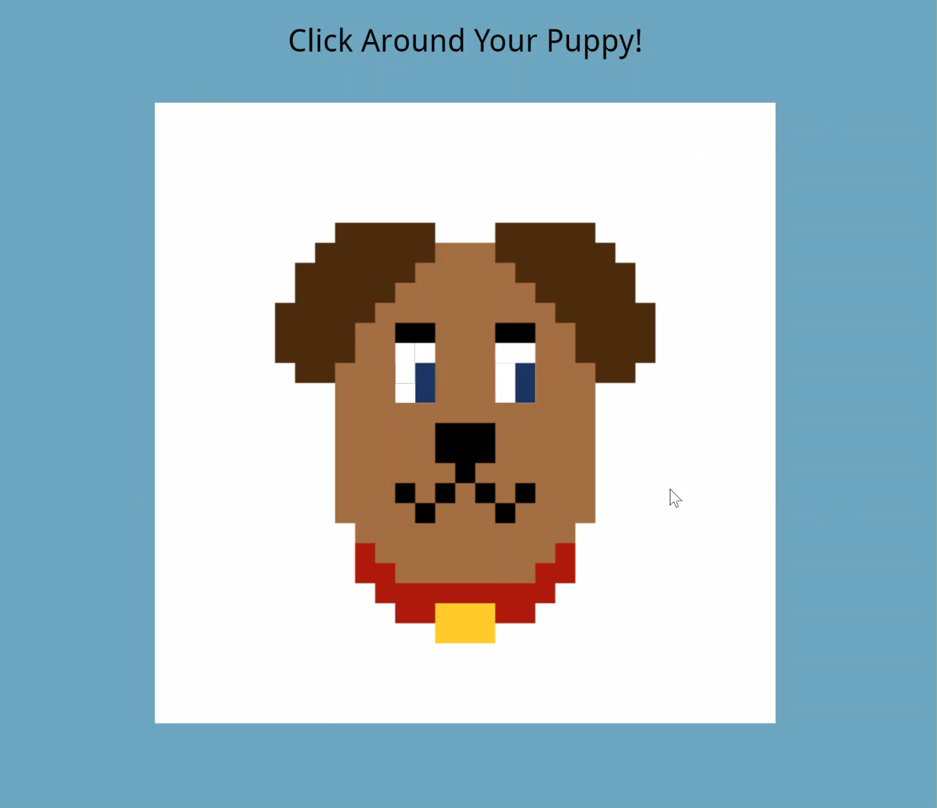
Look!
Image shows the dog looking at the cursor (represented as purple) in the upper left side of the screen.
Second image shows the eyes looking at the cursor at the lower right, representing that it is following it.

Slide 5
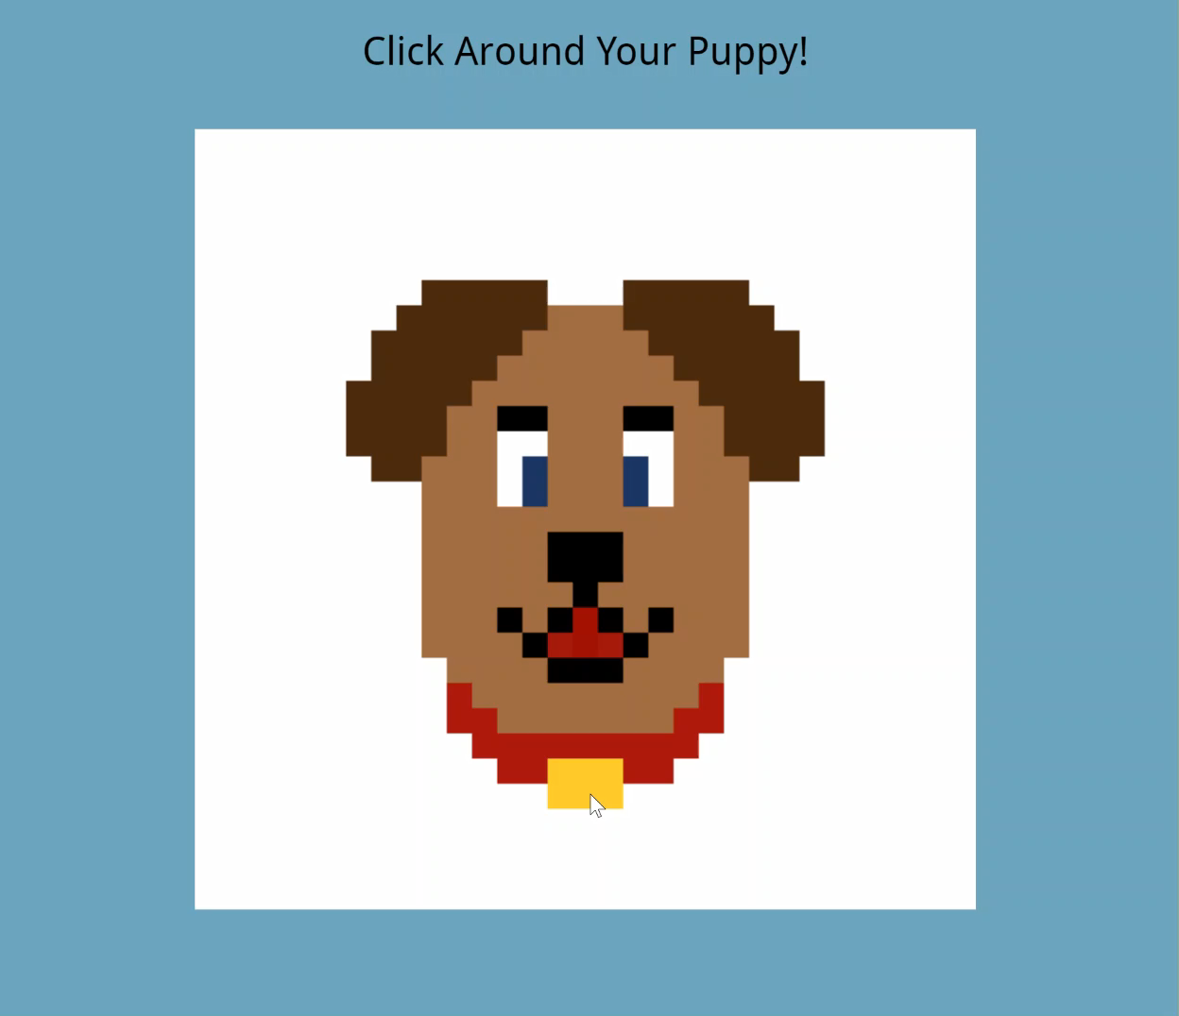

Speak!
Clicking anywhere but the eyes will cause the dog to bark. Clicking different areas cause different barks.

Slide 6
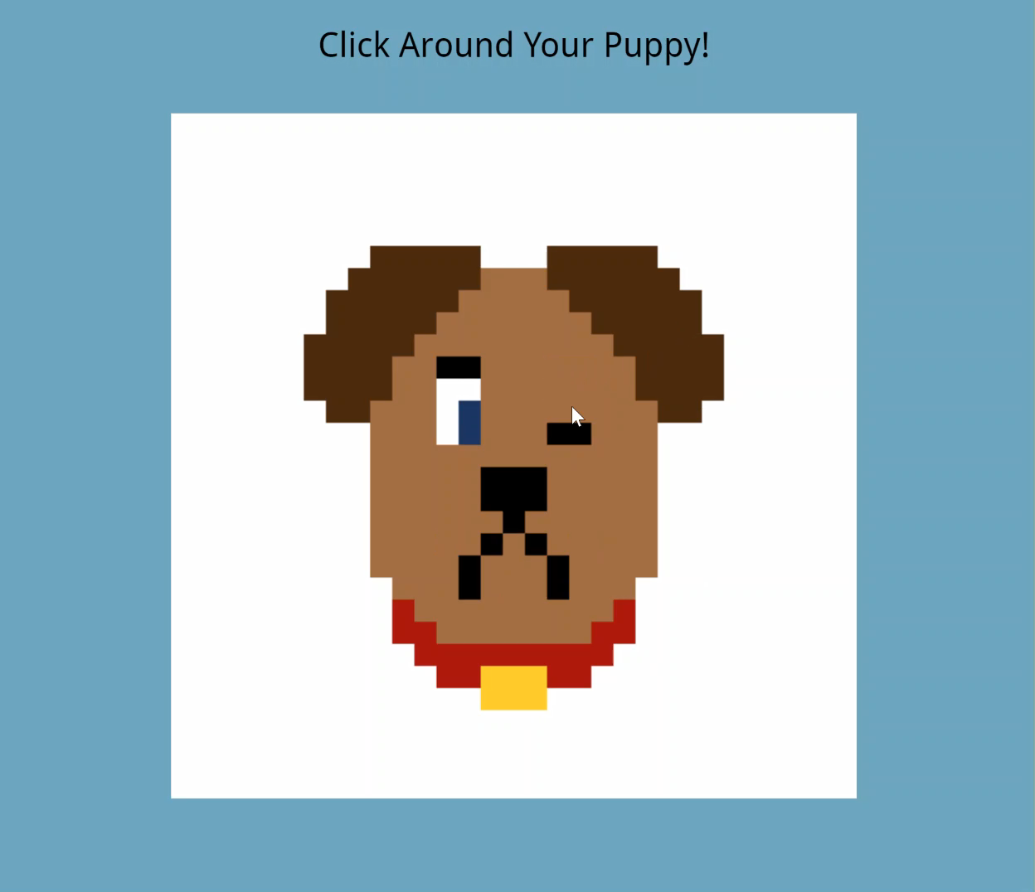
Ouch!
If the mouse is clicked on one of the dog’s eyes, it will wince and frown.

